Slide 1
MEC 402 Casting, Welding and Forming
Dr. Arjyajyoti Goswami
arjyajyoti.Goswami@me.nitdgp.ac.in
+91-9953167384

Slide 2
Weld Defect refers to any departure in welded structure or welded joints from the specified requirements.
According to the International Institute of Welding, the weld defects are classified into six groups as follows:
Cracks
Cavities (blowholes, porosity, shrinkage, etc.)
Solid Inclusion
Incomplete fusion
Imperfect Shape
Miscellaneous defects
Weld defect is different than Weld Discontinuity. Discontinuities are imperfections weld and as a rule it can not be rejected. A discontinuity becomes a defect, hence rejectable, when it exceeds the acceptance limits (type, size and location of discontinuity).
There can be acceptable discontinuities but never acceptable defects.

Slide 3
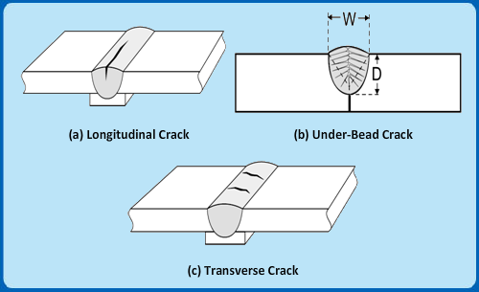
Cracks
These are the most dangerous amongst all types of defects as it reduce the performance of a welded joint drastically and can also cause catastrophic failure.
Categorised on the basis of location and orientation.
These cracks are usually visible and hence, referred to surface defects in weld joints.

Slide 4
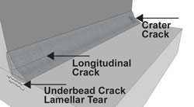
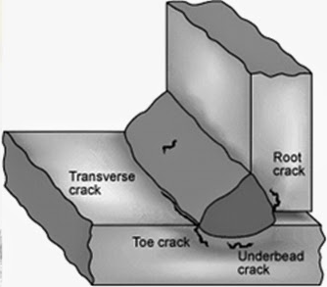
Causes:
the cracks in weld joints occur due to high concentration stresses during solidification of weld, poor fit-up and incorrect welding procedures, and poor edge quality
Remedies:
Formation of cracks can be controlled by preheating the joints, reducing the cooling rate, taking proper precautions during post weld heat treatment

Slide 5
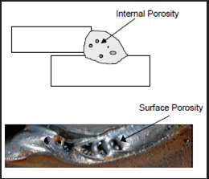
Cavities
These are usually subsurface defects in weld joints and are actually voids, holes or cavities formed by the entrapped gases by the solidified weld metal.
The source of the trapped gas may be uncleaned rust, dirt, paint, etc. on the parent metal or electrode, damp flux (in shielded metal or submerged arc welding), impurities and moisture in the shielding gas.
Normally, porosity is not considered as serious a defect as cracks since the porosity cavities usually have rounded ends which are not expected to propagate as cracks. However, porosities in weld joints are usually not permitted for pressurized containers intended for storage and transportation of liquid, gaseous or inflammable liquids.
The best way to avoid porosity or blowhole in weld joints is to use perfectly clean base materials and baked electrodes.

Slide 6
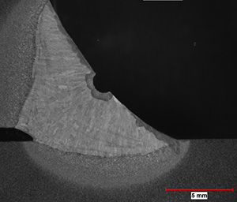
Shrinkage Cavity
It is referred to the cavities which are formed due to shrinkage of weld metal during its solidification. The shrinkage cavity usually occurs during welding of thick plates in a single pass using submerged arc welding or electroslag welding processes. Proper amount of filler material has to be supplied for compensation during shrinkage to avoid this defect.

Slide 7
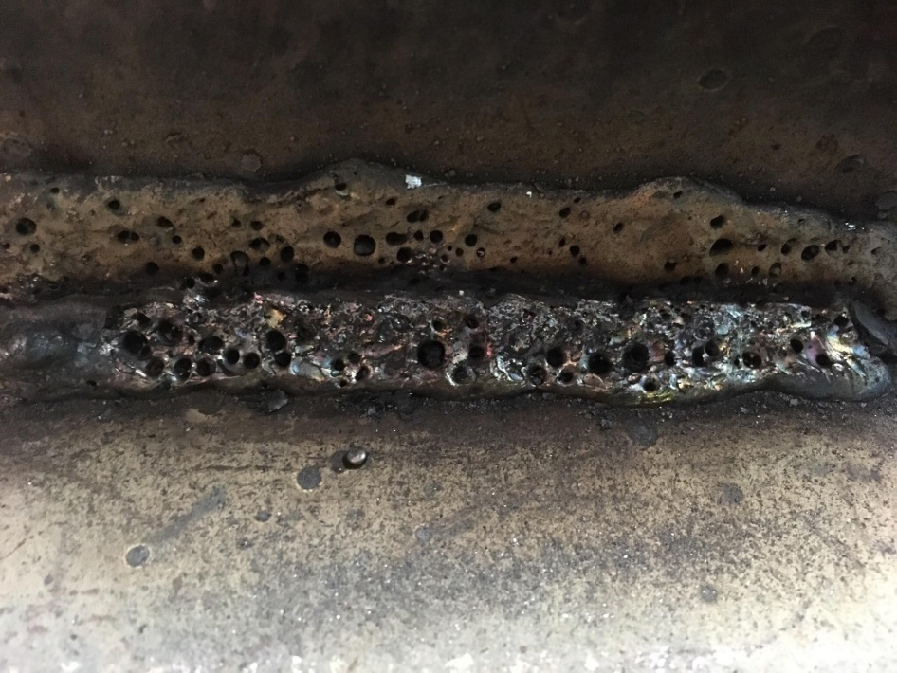
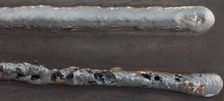
Porosity
Blowholes
Shrinkage Cavity

Slide 8
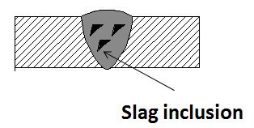
Slag Inclusion
The slag inclusion refers to the solidified flux comprising of oxides, phosphorous compounds and nitrides, which fail to float out to the surface and get entrapped in the weld.
When GTAW is carried out with direct current electrode positive polarity and at high current, tungsten inclusion from the tungsten electrode into the weld can occur.
Such inclusions can be continuous, intermittent or very randomly paced. Slag inclusions reduce the mechanical strength, in particular, the ductility, of the welds.
The number and size of slag inclusion can be minimized by maintaining the weld metal at low viscosity, preventing rapid solidification and maintaining sufficiently high welding temperature.

Slide 9
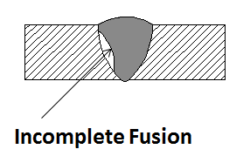
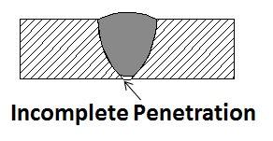
Incomplete Fusion and Penetration
Incomplete fusion can occur due to inadequate welding current, offset of electrode from the axis of the weld, too high a weld speed, improper joint preparation and fit-up.
It occurs between the parent metal and the weld metal and also between intermediate layers in multi-pass welding reducing the weld strength.
Lack of penetration or inadequate penetration usually occurs at the root of the weld and also becomes a built-in crack, which can run through the base metal or weld metal or heat affected zone in actual service condition.

Slide 10
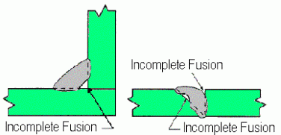

Slide 11
Imperfect Shape
Dimensional deviations , undercut, under fill, overlap, excessive reinforcement, excessive penetration, bead shape are the examples of Imperfect shape.
Underfills and Suckbacks refer to uneven depression (such as a concave contour) respectively, on the face or on the root surface of the weld extending below the surface of the adjacent base metal. Both of these defects reduce the cross-sectional area of the weld below the designed amount and thus, a point of weakness and or stress raiser where failure may occur
Excessive penetration and / or reinforcement are also undesirable in weld joints.
Both are usually caused by poor fit-up, too wide a root gap or too small a root face, improper welding technique and excessive welding current.
Excessive reinforcement tends to stiffen the weld section and make notches that would create stress concentration.

Slide 12
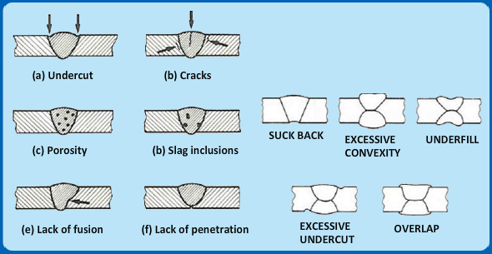

Slide 13
